Slide 1
MA 615 Final Project

Slide 2
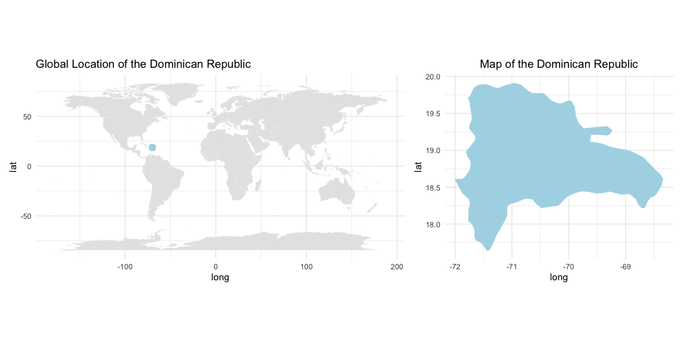
General Description of the Dominican Republic
Location of the Dominican Republic
Here is a map showing where the Dominican Republic is located in the world:

Slide 3
Key Facts About the Dominican Republic
Government: The Dominican Republic is a democratic republic with a president as both the head of state and government.
Economy: The Dominican Republic has one of the largest economies in the Caribbean, with key industries such as tourism, agriculture (e.g., sugar, coffee), and mining.
People: The country has a population of approximately 11 million people, with a rich cultural heritage combining African, European, and indigenous influences.
Natural Environment: The Dominican Republic is home to tropical rainforests, beautiful beaches, and the Caribbean’s highest mountain peak, Pico Duarte.
History: It was the first European colony in the Americas, founded by Christopher Columbus in 1492.

Slide 4
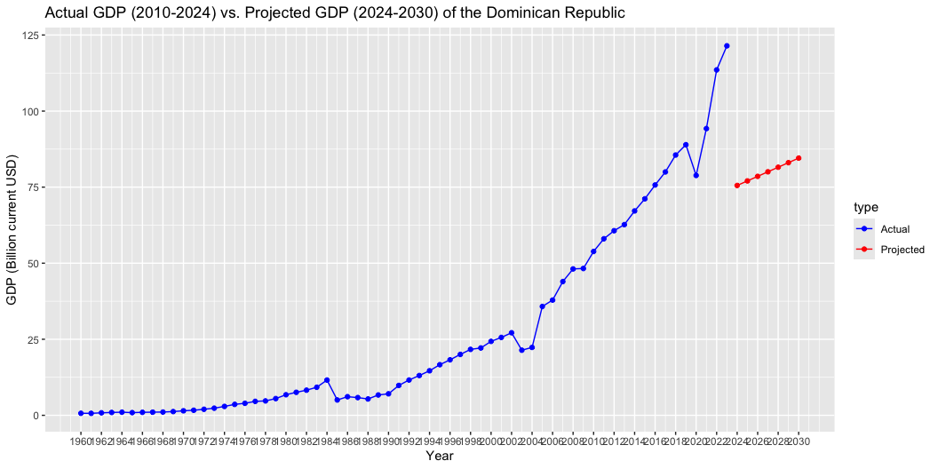
Projection of a Key Variable: GDP of the Dominican Republic

Slide 5
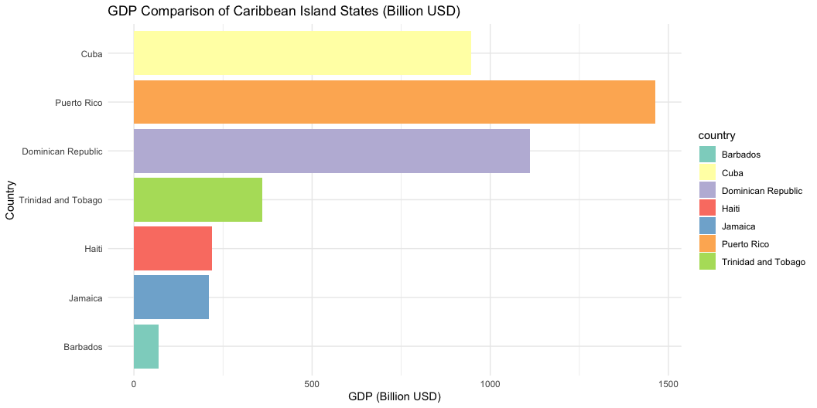
Comparison of the Dominican Republic with Other Caribbean Island States

Slide 6
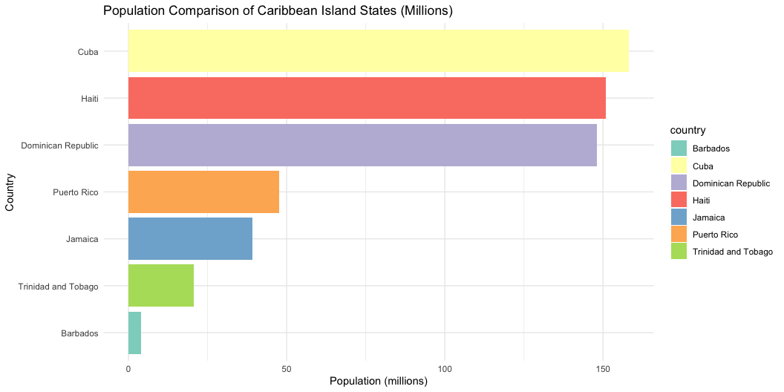

Slide 7
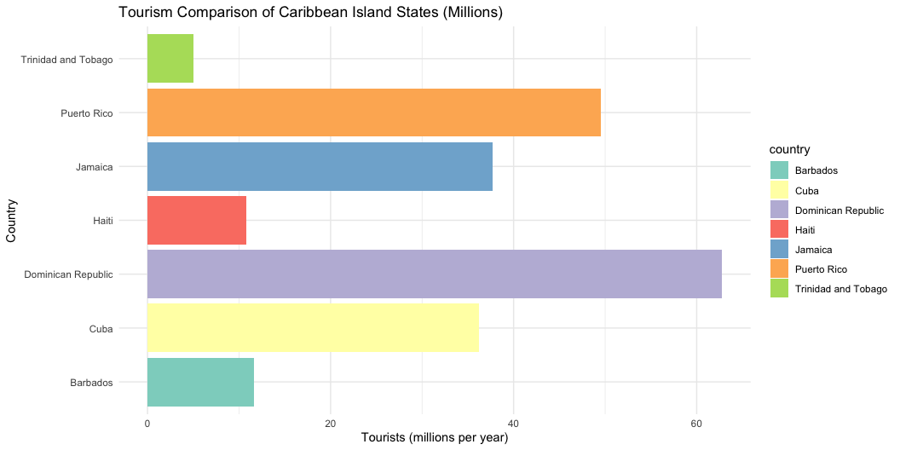

Slide 8
The Dominican Republic, with a population of 10.9 million and a GDP of $94.3 billion, stands out as one of the largest economies in the Caribbean.
Summary and Insights:
GDP: The Dominican Republic has the second-largest GDP in the Caribbean, following Puerto Rico.
Population: It also has the third-largest population among Caribbean island nations in the dataset.
Tourism: The Dominican Republic leads in tourism in the Caribbean, with 7 million visitors annually.

Slide 9
SWOT Analysis of the Dominican Republic
Strengths
Rich cultural heritage and tourism resources.
Growing economy, especially in the tourism sector.
Strategic location for trade.
Weaknesses
Income inequality.
Vulnerability to natural disasters, particularly hurricanes.
Opportunities
Expansion of renewable energy projects.
Growth in international trade and investment.
Threats
Climate change and its impact on agriculture.
Political instability and corruption risks.

Slide 10
References
Image source for Key Facts:
Government: https://encrypted-tbn2.gstatic.com/images?q=tbn:ANd9GcTL6sBDS3B_FC6oclaGT-2kV1iA0leET1q2XAhFgzvDKwhFhLie
Economy: https://www.google.com/imgres?q=dominican%20republic%20economy&imgurl=https%3A%2F%2Fupload.wikimedia.org%2Fwikipedia%2Fcommons%2Fe%2Fe3%2FSantoDomingoedit.JPG&imgrefurl=https%3A%2F%2Fen.wikipedia.org%2Fwiki%2FEconomy_of_the_Dominican_Republic&docid=yciL9Oq5THjl_M&tbnid=dlBOFVcPm2D1KM&vet=12ahUKEwjW5sH_r6GKAxV7MlkFHaIjJYIQM3oECF0QAA..i&w=2359&h=1325&hcb=2&ved=2ahUKEwjW5sH_r6GKAxV7MlkFHaIjJYIQM3oECF0QAA
People: https://www.google.com/imgres?q=dominican%20republic%20people&imgurl=https%3A%2F%2Fupload.wikimedia.org%2Fwikipedia%2Fcommons%2Fthumb%2F0%2F06%2FDominican_Republic_People.JPG%2F300px-Dominican_Republic_People.JPG&imgrefurl=https%3A%2F%2Fen.wikipedia.org%2Fwiki%2FDominicans&docid=phd7j0kaRavQKM&tbnid=svCT_YZkKYqP4M&vet=12ahUKEwiav4KmsKGKAxVbMVkFHUsWNGoQM3oECB0QAA..i&w=300&h=225&hcb=2&ved=2ahUKEwiav4KmsKGKAxVbMVkFHUsWNGoQM3oECB0QAA
Natural Environment: https://www.google.com/imgres?q=dominican%20republic%20natural%20environment&imgurl=https%3A%2F%2Fsimplydominican.com%2Fwp-content%2Fuploads%2F2024%2F07%2FDiscover-the-national-parks-and-natural-wonders-of-the-Dominican-Republic.-275966484.jpg&imgrefurl=https%3A%2F%2Fsimplydominican.com%2Fdiscover-national-parks-natural-wonders-dominican-republic%2F&docid=Y447fw3Vvfvp3M&tbnid=BwE702EIkgnO0M&vet=12ahUKEwiz__2xsKGKAxUxFFkFHfi4Ei0QM3oECEkQAA..i&w=1344&h=768&hcb=2&ved=2ahUKEwiz__2xsKGKAxUxFFkFHfi4Ei0QM3oECEkQAA", History: https://www.google.com/imgres?q=dominican%20republic%20natural%20history&imgurl=https%3A%2F%2Fupload.wikimedia.org%2Fwikipedia%2Fcommons%2F4%2F43%2FDesangles_Colon_engrillado.jpg&imgrefurl=https%3A%2F%2Fen.wikipedia.org%2Fwiki%2FHistory_of_the_Dominican_Republic&docid=27II5zZ--50ftM&tbnid=uAFvRHC7mBo-5M&vet=12ahUKEwjUj9jCsKGKAxVRFFkFHc-WA-AQM3oECHkQAA..i&w=708&h=532&hcb=2&ved=2ahUKEwjUj9jCsKGKAxVRFFkFHc-WA-AQM3oECHkQAA"
SWOT Analysis:
Strengths: https://www.worldbank.org/en/country/dominicanrepublic/overview
Weaknesses: https://www.undrr.org/
Opportunities: https://www.irena.org/
Threats: https://unfccc.int/

